Slide 1
Physics-Informed Machine Learning: The Next Evolution in Neural Network Development
Karriem (A.J.) Perry, Ph.D.
Senior Data Scientist - Public Sector
Artificial Intelligence Dissertation Committee Chair - Capitol Technology University

Slide 2
Agenda
What is Physics-Informed Machine Learning (PIML) and its utility?
Foundations of PIML.
PIML in Action.
Recommended Individual Development Environments (IDEs)
What’s Next for PIML.
Related links, works, contact info.
Questions.
References.

Slide 3
Disclaimer: The opinions expressed in this presentation are solely those of the author and are not those of affiliated institutions or organizations.

Slide 4
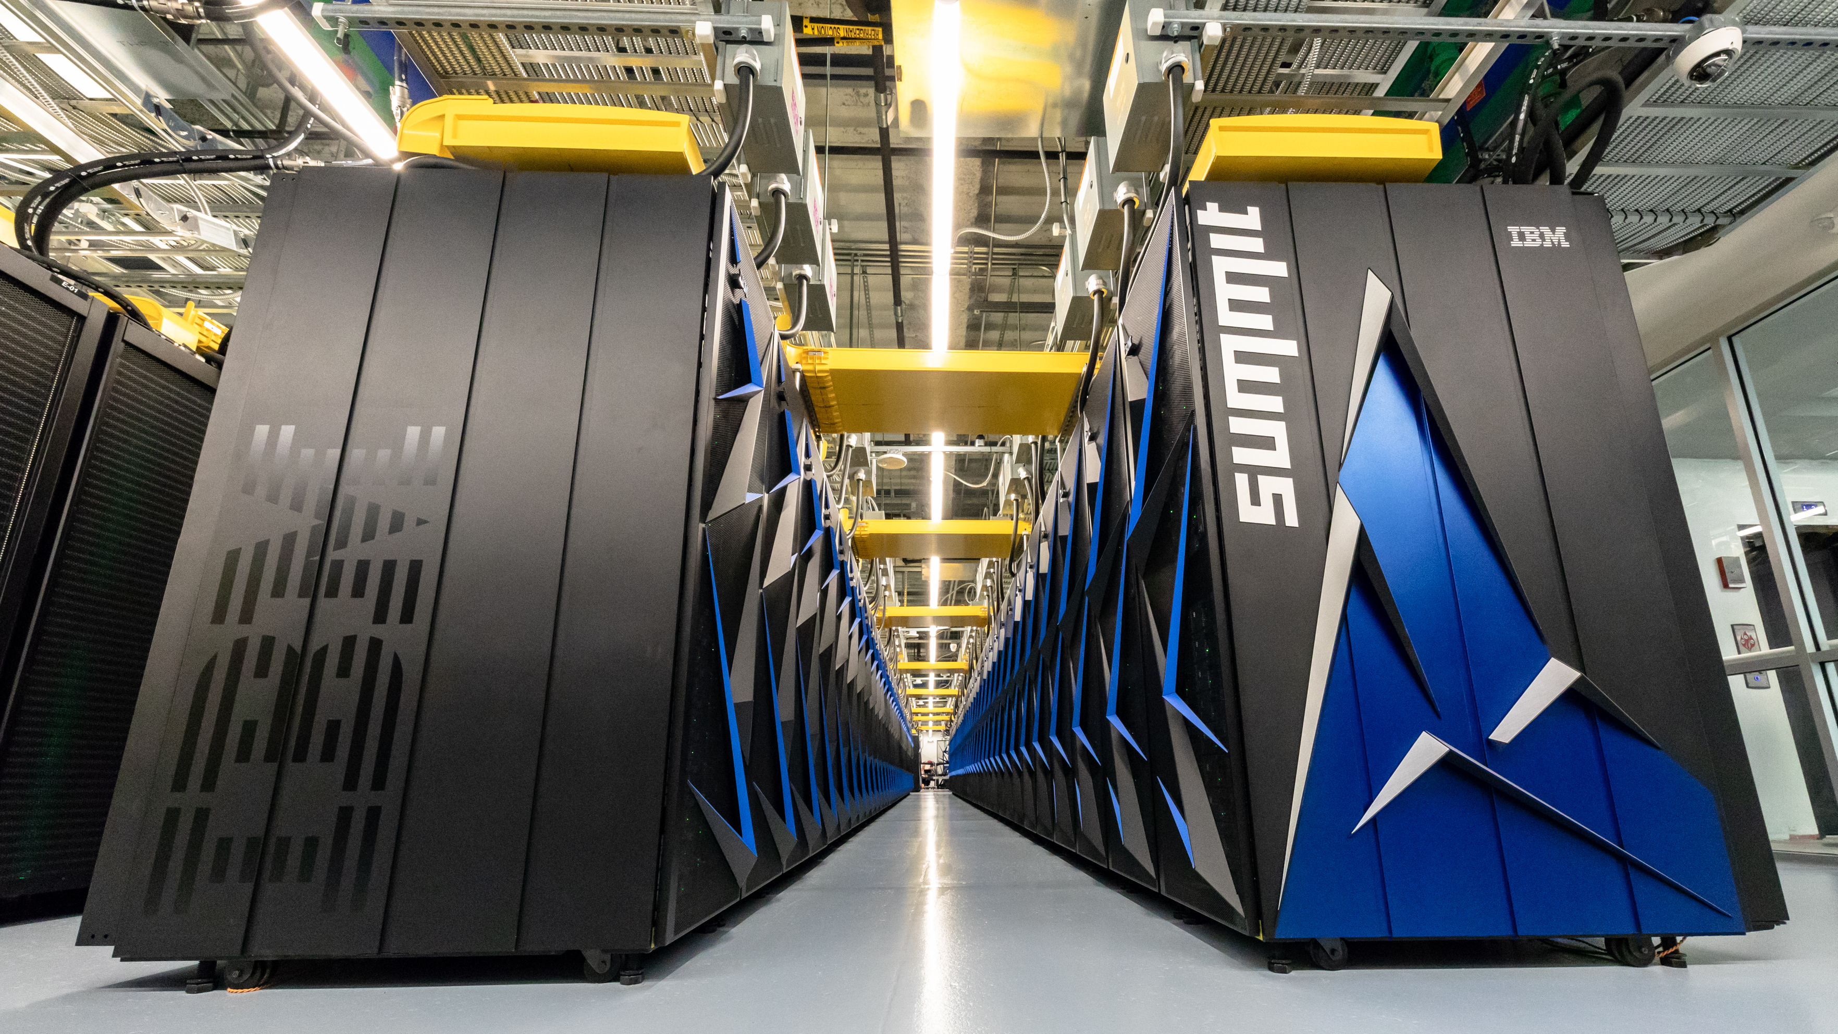
What is physics-informed machine learning and its utility?
Physics-informed machine learning (PIML), as a derivative of scientific machine learning (SciML), emerged approximately in mid-late 1990s at or about the end of the 2nd Artificial Intelligence Winter [1]. Applying this method in developing for instance, machine learning models, has proved especially useful when data availability or data quality are in question, particularly in the physical sciences, e.g., biological, astrological, chemical etc. and engineering technology [2].
ML, in particular deep learning has a significant impact on simulating these physical properties. In addition, research is emerging postulating the utility of PIML in fields distinctly separate from the physical sciences involving applications in the social sciences when considering stochastic partial differential and nonlinear partial differential equations [4].
Courtesy: Argonne National Laboratory, U.S. Department of Energy (Almgren et al., 2017); [3].
Notes:
The emergence likely comes out of academia and or the National Laboratories. PIML assists in simulating the mapping of input to output, from prior knowledge of physical phenomena.; developing the approximators of the neural net’s node calculations. ; The term “SciML” is derived from a technical report developed in the public sector published in 2019.

Slide 5
Foundations of PIML
As previously referenced, partial differential equations (PDEs) are the foundation of SciML [5]. PDEs can mathematically describe most know physical systems currently know and promote the ability to parameterize ML models in ways not usually transparent from traditional parameterization methods [6].
Consider the Brownian Motion, Schrodinger’s Wave, Helmholtz’s, Poisson's, Navier-Stokes’, and many other equations and derivatives [7]. Key, is a sufficient understanding of the characteristics and limitations of both the chosen PDE(s) applied and those of the problem(s) to be solved. Arguably, the theorems are solely limited to known physical laws and the proofs of the researcher.
AI generated, WOMBO Dream, Scientific machine learning laboratory (Perry, 2022).

Slide 6
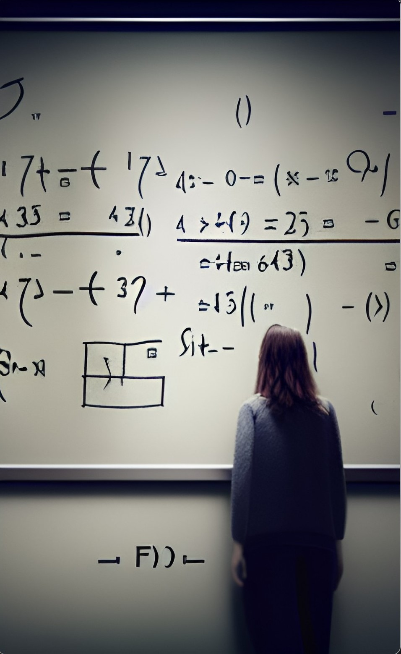
PIML in Action
Performing calculations associated with PIML vary. However, in calculus there are initial conditions that are standard, and these expectations must be met. A generic equation may follow something of this sort:
“…in its most general form, the [Universal Differential Equation] UDE is a forced stochastic delay partial differential equation ([SD]PDE) defined with embedded universal approximators:
$𝒩\left[u\left(t\right),\left(α\left(t\right)\right),W\left(t\right),U_{θ}(u,β\left(t\right))\right]=0$
where $α\left(t\right)$ is a delay function and $W\left(t\right)$ is the Weiner process.” (pg. 3); [8]
The above differential equations are meant to show the relations between a common function; in this instance $α\left(t\right)$ is a function of time. Where $\left[\frac{dy}{dx}∙\frac{y}{x}=α\right]$ represents the initial stages of determining what alpha is a function of. In a nutshell, swapping out the Weiner process with perhaps the Lévy process, leads to an entirely different set of conditions that may be applicable to the parameters of the ML model(s) in question.
AI generated, WOMBO Dream, Woman examining PDEs (Perry, 2022).
Notes:
To illustrate the trade-offs associated with human-handcrafting, or the absence thereof, we first must quantify considerations defining involvement of the human element as applied to cybersecurity (Angelov, 2019; Kulp et al., 2020). Considering the complexity, likely asymptoticity, and probable non-linearity of the covariates; to accomplish this, we used a Universal Differential Equation (UDE) to develop a human-in-the-loop Delay Differential Equation (DDE); (Soetaert, 2012) variant highlighting prior event variables defining the physics and using separation of variables methods; in three-dimensional space, represented as inducing human interactions (Rackaukas et al., 2020; Robinson, 2021). As described by the researcher Rackaukas (2020),
“…in its most general form, the UDE is a forced stochastic delay partial differential equation (PDE) defined with embedded universal approximators:
$𝒩\left[u\left(t\right),\left(α\left(t\right)\right),W\left(t\right),U_{θ}(u,β\left(t\right))\right]=0[$,]
where $α\left(t\right)$ is a delay function and $W\left(t\right)$ is the Weiner process.” (pg. 3)
The delay function helps use quantify the activities associated with human-handcrafting as fundamental to the function reaction time of human-in-the-loop (h), essentially a derivation of time (t) which has a significant role in a three-dimensional space including the Lévy process. Therefore, we explain our position in the following:
Definition 1. Assuming a system’s composition can be demonstrated in the form:
$x^{′}\left(t\right)=f\left(x\left(t\right),x(t−1)\right),L(t), t\int_{0}^{1}{, x(t)∈ℝ^{n}}$ , (5.1)
where $\left(t\right)≅1$ and $L(t)$ the Lévy process. Probabilistically we deduce $p\left(x,t\right)$ to a distribution of the state of a given system (Taylor, 2004).

Slide 7
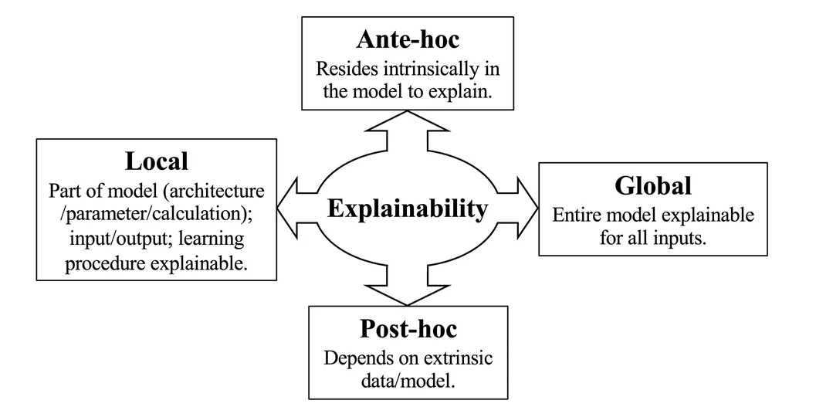
PIML in Action…Cont.
Along with the standard calculations and exploratory data analysis procedures, Since these are not a business analytics processes, CRISP-DM or ASUM-DM are obsolete. I recommend following a reproducible ML modeling / analysis methodology. In this instances, we’ll use a modification of an Explainable AI (XAI) framework [9].
A crucial consideration is the explainability factor of a ML model; which is readily available in the extrinsic properties of the Post-hoc stage, is the objective description of model performance [10]. The math answers most, if not all these questions and concerns; with a few exceptions. However, PIML is one of several ways to explain ML activities quantitively.
Explainable AI Framework. (Zimmerman, 2002)
Notes:
Many may know of CRISP-DM or ASUM-DM, which is the Cross-Industry Standard Process for Data Mining or the Cross Industry Standard Process for Data Mining (CRISP-DM). Different scopes and aspects of explainability.
These exceptions are from a probabilistic perspective. Explainability is not a binary property. In other words, not all explanations address the ante-hoc global explainability of the entire model. Post-doc/local explanations are also acceptable.

Slide 8
PIML in Action…Cont.
Dr. Craig Gin explains a very interesting and useful experiment on how his team achieved linearization in deep learning models, in this short clip.
Gin, C., Lusch, B., Brunton, S. L., & Kutz, J. N. (2021). Deep learning models for global coordinate transformations that linearise PDEs. European Journal of Applied Mathematics, 32(3), 515-539 [8].
Notes:
Stop at 2:04. What does this mean? Well, it depends on what you’re trying to accomplish. Craig is clearly concerned with linearizing some function u(t). The theory helps describe the conditions to the ML modeling in question. In this instance a deep learning neural network. The takeaway is that model performance is ultimately based on the conditions, as described by the given physical system, feed into the parameters of the neural network.

Slide 9
Recommended Software Stack(s)
Along with the standard calculations and exploratory data analysis procedures, I recommend following a reproducible modeling / analysis methodology. In this instances, we’ll use the flexible software stack tailored to the unique specifications of model development.
In addition, individual development environments are also available for you to customize to your specifications.
Courtesy: Google Summer Code w/ NumFocus 2019 [12].

Slide 10
Links of Interest, Current & Upcoming Works, Contact Info
Links:
Deep learning models for global coordinate transformations that linearise PDEs – YouTube
Rethinking Physics Informed Neural Networks [NeurIPS'21] – YouTube
https://www.pnnl.gov/search?keyword=physics-informed
Pre-Print: Plant Breeding Biomolecular Classification in Quantum Bayesianism (QBism) Physics- Informed Neural Network Architecture – EarthArXiv.org
B. Keary
A.J. Perry
Upcoming:
Metadata Causal Inference of Concept Drifts in Statistical-Relational Machine Learning: Predictive Analytics Using Graph Theory Methods in Cyber-Defense
A.J. Perry
B. Keary
P. Kulp
Scientific and Probabilistic Approaches to the Quantification of Human Capital Management: How Machine Learning is Advancing Human Resources
B. Keary
A.J. Perry
Contact: kaperry@captechu.edu
GitHub: https://github.com/AJ-Perry
Notes:
To illustrate the trade-offs associated with human-handcrafting, or the absence thereof, we first must quantify considerations defining involvement of the human element as applied to cybersecurity (Angelov, 2019; Kulp et al., 2020). Considering the complexity, likely asymptoticity, and probable non-linearity of the covariates; to accomplish this, we used a Universal Differential Equation (UDE) to develop a human-in-the-loop Delay Differential Equation (DDE); (Soetaert, 2012) variant highlighting prior event variables defining the physics and using separation of variables methods; in three-dimensional space, represented as inducing human interactions (Rackaukas et al., 2020; Robinson, 2021). As described by the researcher Rackaukas (2020),
“…in its most general form, the UDE is a forced stochastic delay partial differential equation (PDE) defined with embedded universal approximators:
$𝒩\left[u\left(t\right),\left(α\left(t\right)\right),W\left(t\right),U_{θ}(u,β\left(t\right))\right]=0[$,]
where $α\left(t\right)$ is a delay function and $W\left(t\right)$ is the Weiner process.” (pg. 3)
The delay function helps use quantify the activities associated with human-handcrafting as fundamental to the function reaction time of human-in-the-loop (h), essentially a derivation of time (t) which has a significant role in a three-dimensional space including the Lévy process. Therefore, we explain our position in the following:
Definition 1. Assuming a system’s composition can be demonstrated in the form:
$x^{′}\left(t\right)=f\left(x\left(t\right),x(t−1)\right),L(t), t\int_{0}^{1}{, x(t)∈ℝ^{n}}$ , (5.1)
where $\left(t\right)≅1$ and $L(t)$ the Lévy process. Probabilistically we deduce $p\left(x,t\right)$ to a distribution of the state of a given system (Taylor, 2004).

Slide 11
References
[1] Muthukrishnan, N., Maleki, F., Ovens, K., Reinhold, C., Forghani, B.,- & Forghani, R. (2020). Brief history of artificial intelligence. Neuroimaging Clinics, 30(4), 393-399.
[2] Karniadakis, G. E., Kevrekidis, I. G., Lu, L., Perdikaris, P., Wang, S., & Yang, L. (2021). Physics-informed machine learning. Nature Reviews Physics, 3(6), 422-440.
[3] Almgren, A., DeMar, P., Vetter, J., Riley, K., Antypas, K., Bard, D., ... & Williams, S. (2017). Advanced scientific computing research exascale requirements review. an office of science review sponsored by advanced scientific computing research, september 27-29, 2016, rockville, maryland. Argonne National Lab.(ANL), Argonne, IL (United States). Argonne Leadership Computing Facility.
[4] Radford, J., & Joseph, K. (2020). Theory In, Theory Out: The Uses of Social Theory in Machine Learning for Social Science. Frontiers in Big Data, 3.
[5] [6] Rackauckas, C., Ma, Y., Martensen, J., Warner, C., Zubov, K., Supekar, R., ... & Edelman, A. (2020). Universal differential equations for scientific machine learning. arXiv preprint arXiv:2001.04385.
[7] Miller, K. S. (2020). Partial differential equations in engineering problems. Courier Dover Publications.
[8] Gin, C., Lusch, B., Brunton, S. L., & Kutz, J. N. (2021). Deep learning models for global coordinate transformations that linearise PDEs. European Journal of Applied Mathematics, 32(3), 515-539.
[9][10] Angée, S., Lozano-Argel, S. I., Montoya-Munera, E. N., Ospina-Arango, J. D., & Tabares-Betancur, M. S. (2018, August). Towards an improved ASUM-DM process methodology for cross-disciplinary multi-organization big data & analytics projects. In International Conference on Knowledge Management in Organizations (pp. 613-624). Springer, Cham.
[11] Zimmerman, M. J. (2002). Intrinsic vs. extrinsic value.
[12] Loyola, J. M. GSoC 2019 Final Evaluation.

Slide 12
Questions
Notes:
To illustrate the trade-offs associated with human-handcrafting, or the absence thereof, we first must quantify considerations defining involvement of the human element as applied to cybersecurity (Angelov, 2019; Kulp et al., 2020). Considering the complexity, likely asymptoticity, and probable non-linearity of the covariates; to accomplish this, we used a Universal Differential Equation (UDE) to develop a human-in-the-loop Delay Differential Equation (DDE); (Soetaert, 2012) variant highlighting prior event variables defining the physics and using separation of variables methods; in three-dimensional space, represented as inducing human interactions (Rackaukas et al., 2020; Robinson, 2021). As described by the researcher Rackaukas (2020),
“…in its most general form, the UDE is a forced stochastic delay partial differential equation (PDE) defined with embedded universal approximators:
$𝒩\left[u\left(t\right),\left(α\left(t\right)\right),W\left(t\right),U_{θ}(u,β\left(t\right))\right]=0[$,]
where $α\left(t\right)$ is a delay function and $W\left(t\right)$ is the Weiner process.” (pg. 3)
The delay function helps use quantify the activities associated with human-handcrafting as fundamental to the function reaction time of human-in-the-loop (h), essentially a derivation of time (t) which has a significant role in a three-dimensional space including the Lévy process. Therefore, we explain our position in the following:
Definition 1. Assuming a system’s composition can be demonstrated in the form:
$x^{′}\left(t\right)=f\left(x\left(t\right),x(t−1)\right),L(t), t\int_{0}^{1}{, x(t)∈ℝ^{n}}$ , (5.1)
where $\left(t\right)≅1$ and $L(t)$ the Lévy process. Probabilistically we deduce $p\left(x,t\right)$ to a distribution of the state of a given system (Taylor, 2004).

